Slide 1
Lecture 8 Advanced Binary Tree
Ran Cheng (程然)
https://chengran.tech/
https://emi.sustech.edu.cn/

Slide 2
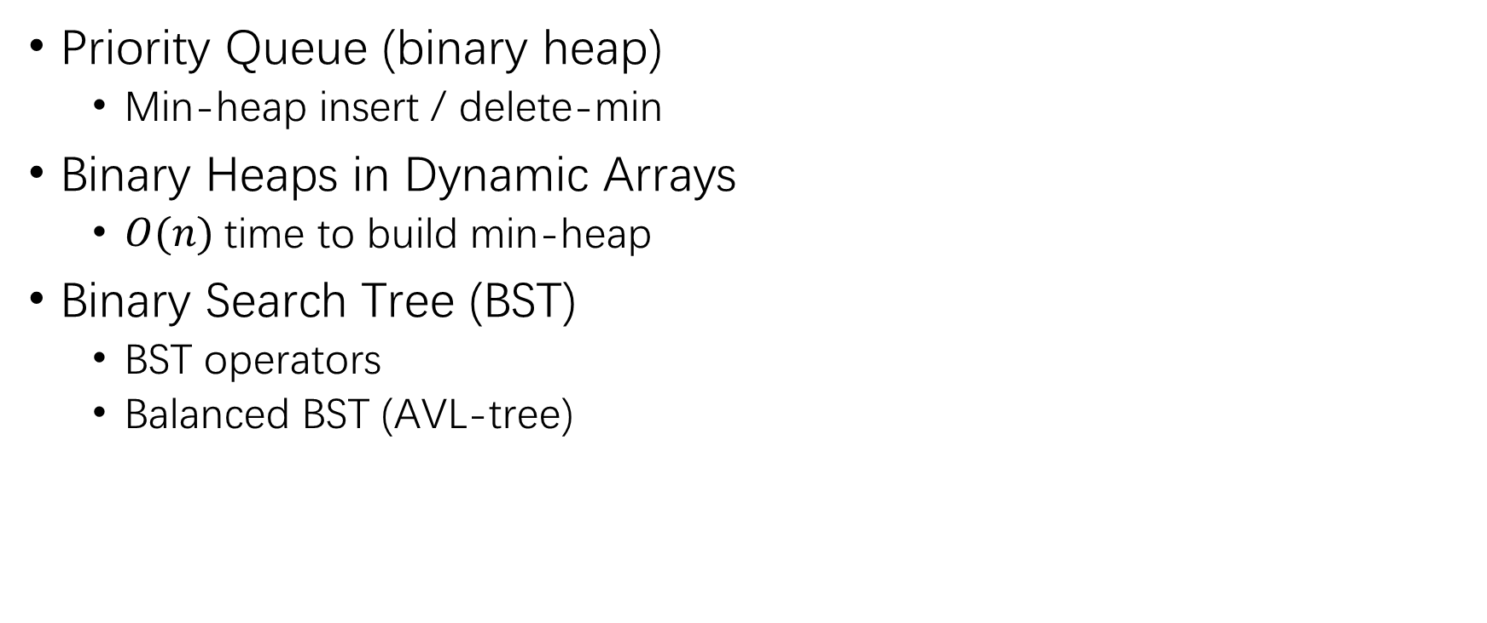
Our Roadmap
Priority Queue (binary heap)
Min-heap insert / delete-min
Binary Heaps in Dynamic Arrays
$O(n)$time to build min-heap
Binary Search Tree (BST)
BST operators
Balanced BST (AVL-tree)

Slide 3
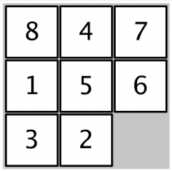
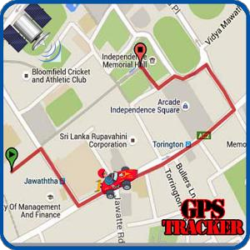
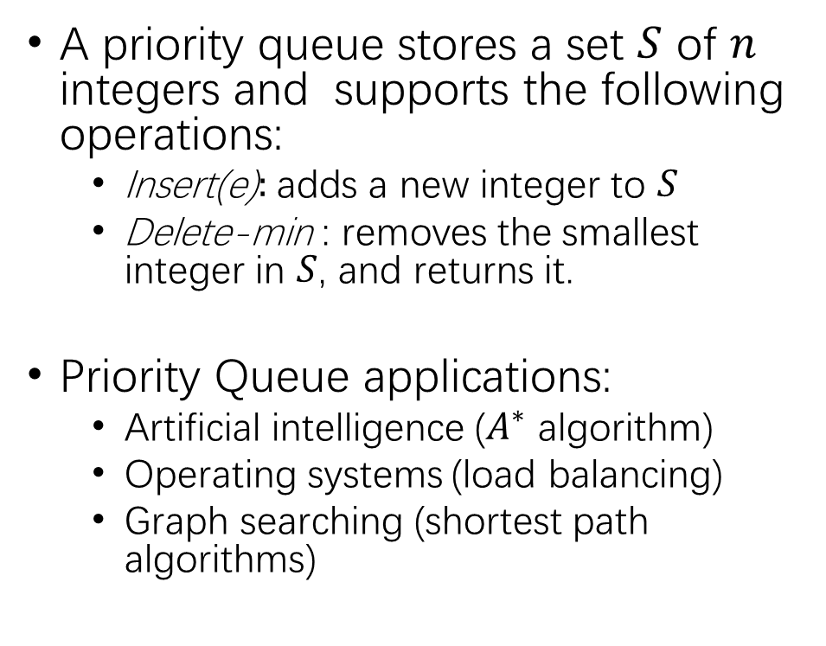
Priority Queue
A priority queue stores a set $S$ of $n$ integers and supports the following operations:
Insert(e)$:$adds a new integer to $S$
Delete-min$⁡$: removes the smallest integer in $S$, and returns it.
Priority Queue applications:
Artificial intelligence ($A^{∗}$ algorithm)
Operating systems (load balancing)
Graph searching (shortest path algorithms)

Slide 4
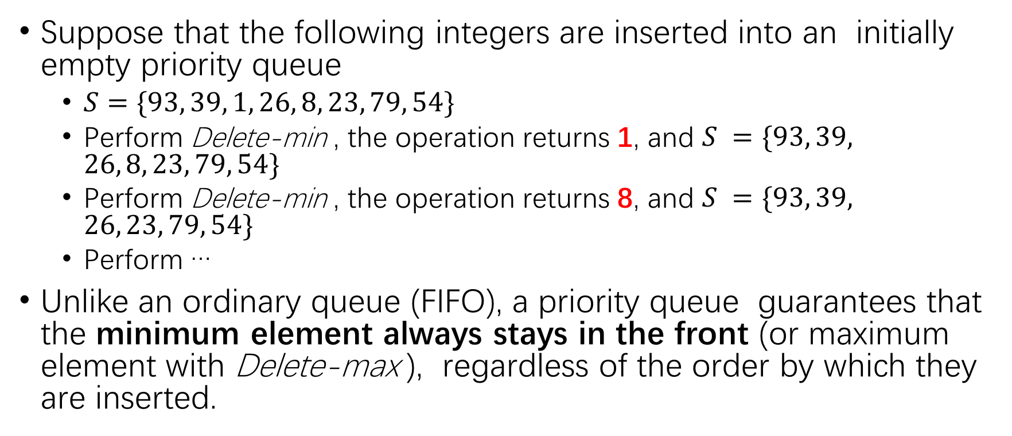
Priority Queue Example
Suppose that the following integers are inserted into an initially empty priority queue
$S=\{93, 39, 1, 26, 8, 23, 79, 54\}$
Perform Delete-min$⁡$, the operation returns 1, and $S =\{93, 39, 26, 8, 23, 79, 54\}$
Perform Delete-min$⁡$, the operation returns 8, and $S =\{93, 39, 26, 23, 79, 54\}$
Perform …
Unlike an ordinary queue (FIFO), a priority queue guarantees that the minimum element always stays in the front (or maximum element with Delete-max$⁡$), regardless of the order by which they are inserted.

Slide 5
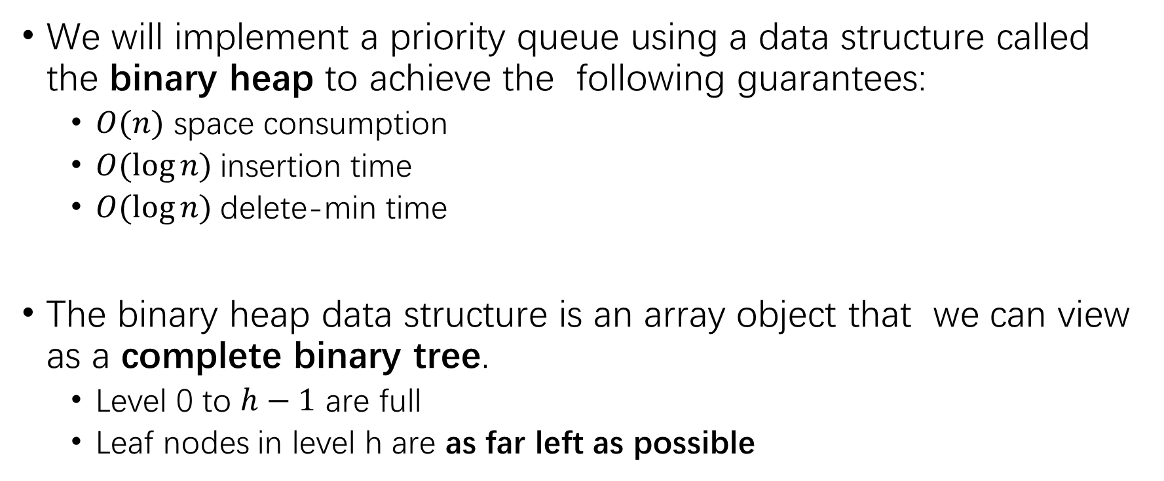
Priority Queue Implementation
We will implement a priority queue using a data structure called the binary heap to achieve the following guarantees:
$O(n)$ space consumption
$O(log⁡n)$insertion time
$O(log⁡n)$delete-min time
The binary heap data structure is an array object that we can view as a complete binary tree.
Level 0 to $h−1$ are full
Leaf nodes in level h are as far left as possible

Slide 6
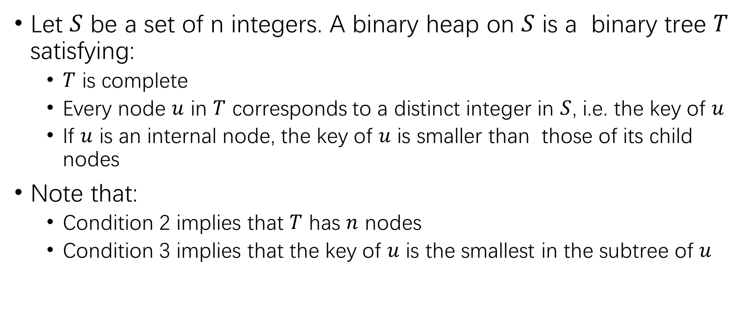
Binary Heap
Let $S$ be a set of n integers. A binary heap on $S$ is a binary tree $T$ satisfying:
$T$ is complete
Every node $u$ in $T$ corresponds to a distinct integer in $S$, i.e. the key of $u$
If $u$ is an internal node, the key of $u$ is smaller than those of its child nodes
Note that:
Condition 2 implies that $T$ has $n$ nodes
Condition 3 implies that the key of $u$ is the smallest in the subtree of $u$

Slide 7
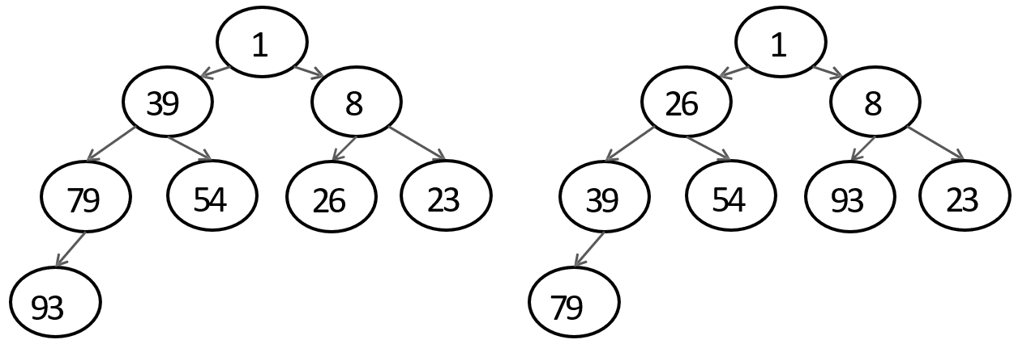
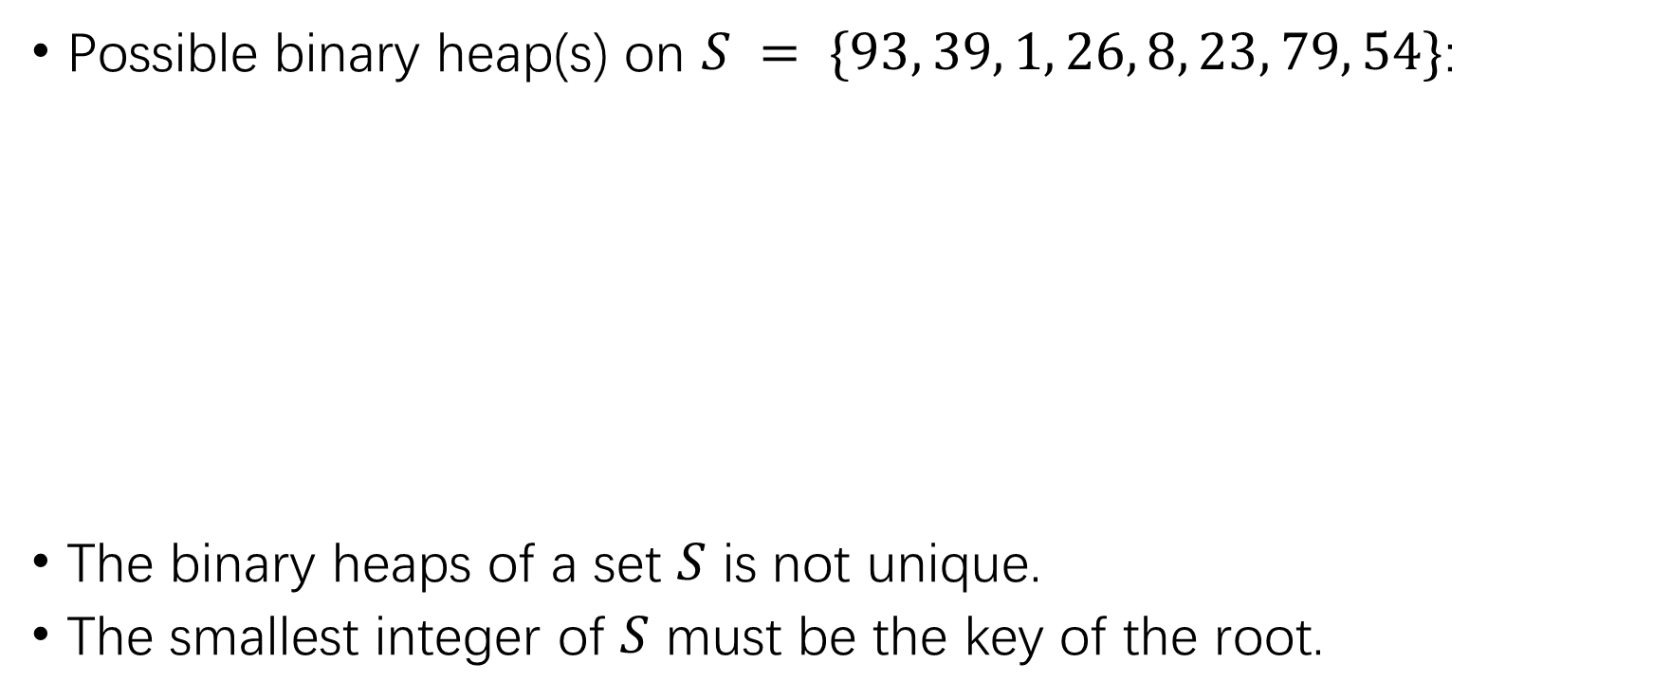
Binary Heap Example
Possible binary heap(s) on $S = \{93, 39, 1, 26, 8, 23, 79, 54\}$:
The binary heaps of a set $S$ is not unique.
The smallest integer of $S$ must be the key of the root.

Slide 8
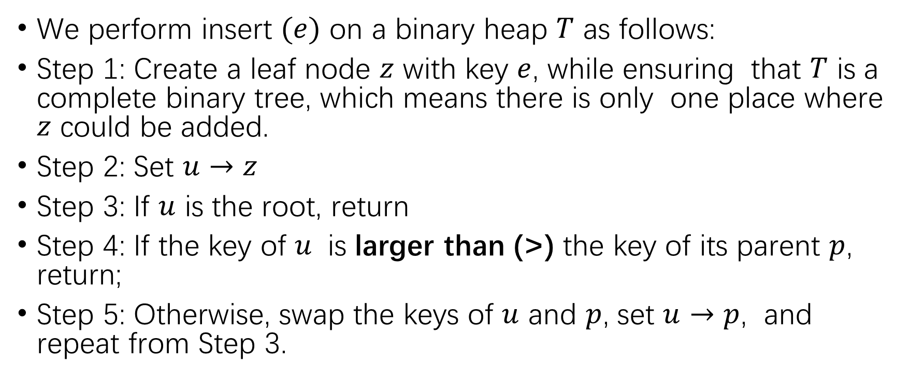
Binary Heap Insertion
We perform insert $(e)$ on a binary heap $T$ as follows:
Step 1: Create a leaf node $z$ with key $e$, while ensuring that $T$ is a complete binary tree, which means there is only one place where $z$ could be added.
Step 2: Set $u→z$
Step 3: If $u$ is the root, return
Step 4: If the key of $u$ is larger than (>) the key of its parent $p$, return;
Step 5: Otherwise, swap the keys of $u$ and $p$, set $u→p$, and repeat from Step 3.

Slide 9

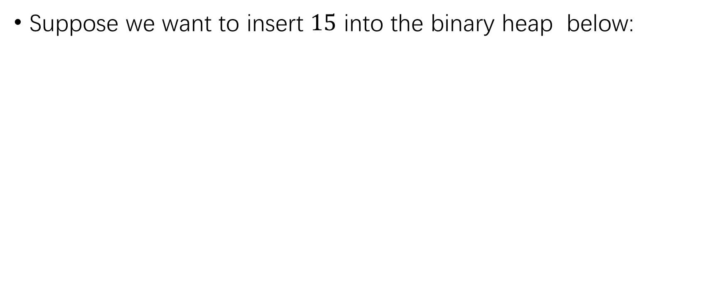
Binary Heap Insertion
Suppose we want to insert $15$ into the binary heap below:
1
39
8
79
54
26
23
93

Slide 10
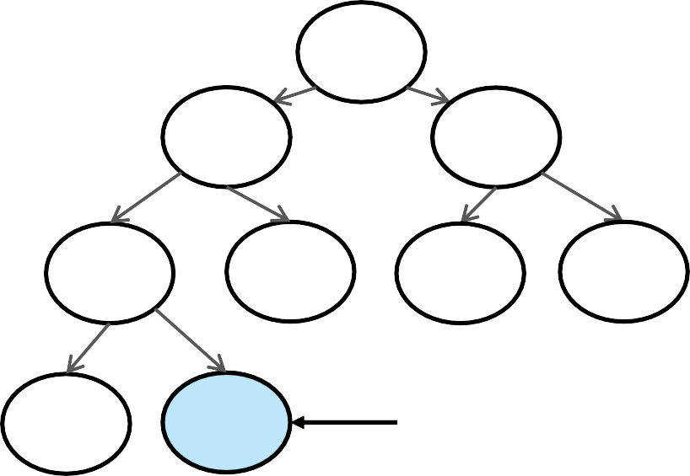
Binary Heap Insertion
First add 15 as a new leaf, making sure that we still have a complete binary tree.
Step 3 is not true, go to Step 4,
Step 4 is not true, go to Step 5.
1
39
8
79
54
26
23
93 15 u

Slide 11
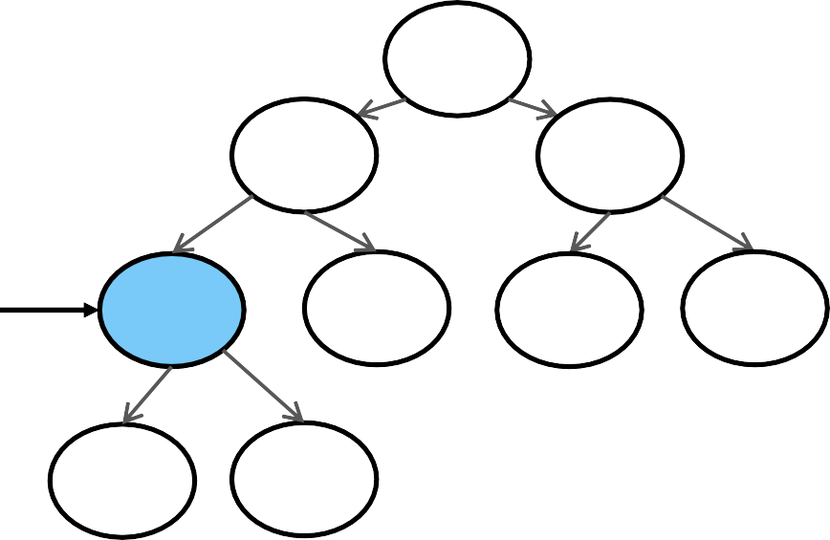
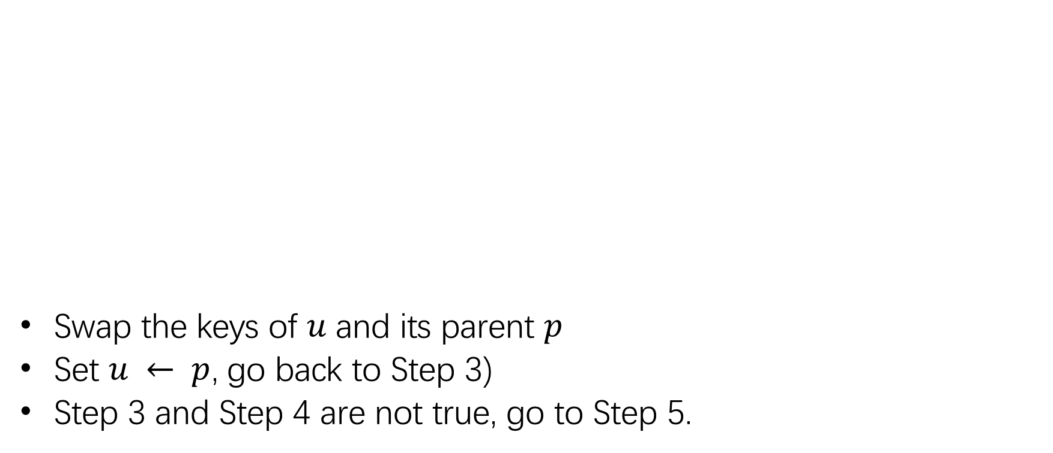
Binary Heap Insertion
Swap the keys of $u$ and its parent $p$
Set $u ← p$, go back to Step 3)
Step 3 and Step 4 are not true, go to Step 5.
1
39
8
u
15
93 79
54
26
23

Slide 12
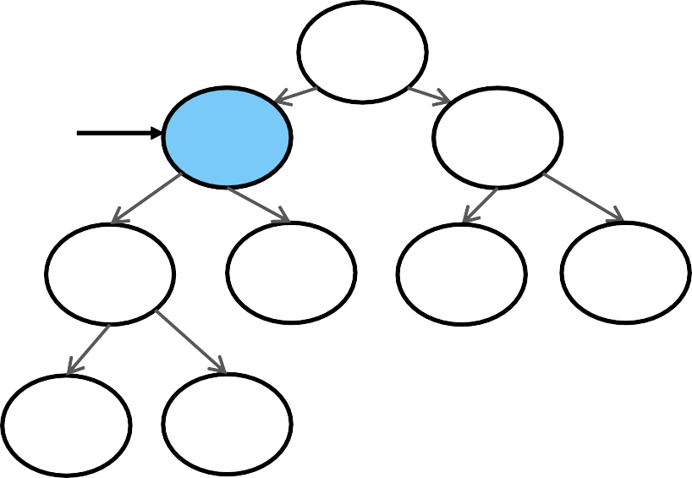
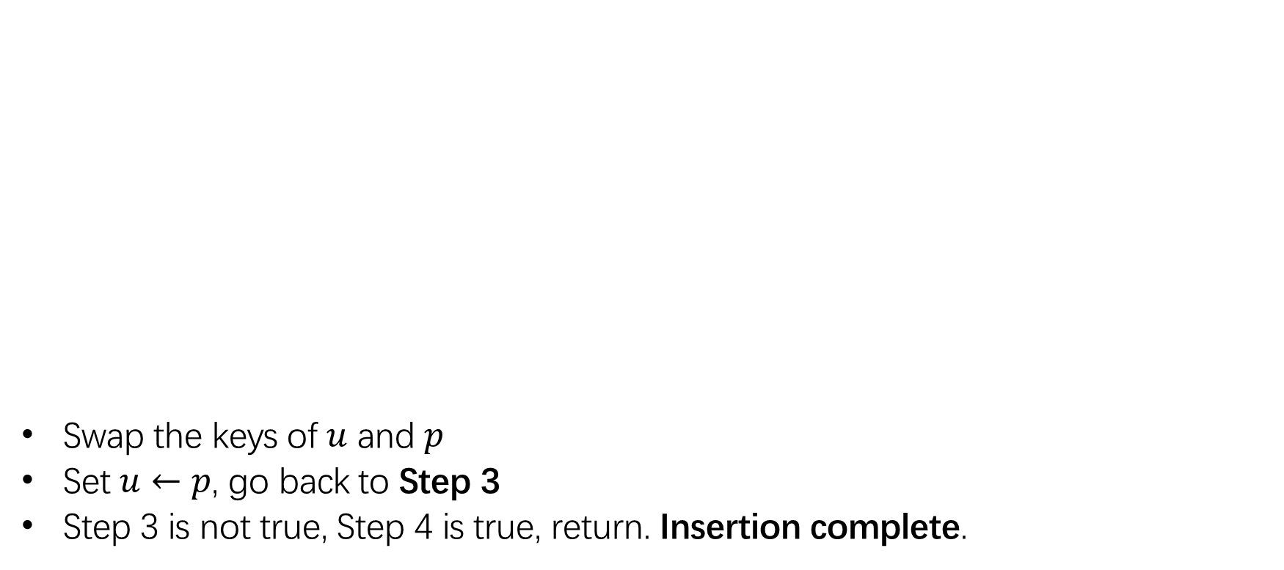
Binary Heap Insertion
Swap the keys of $u$ and $p$
Set $u←p$, go back to Step 3
Step 3 is not true, Step 4 is true, return. Insertion complete.
1
u
15
8
39
93 79
54
26
23

Slide 13
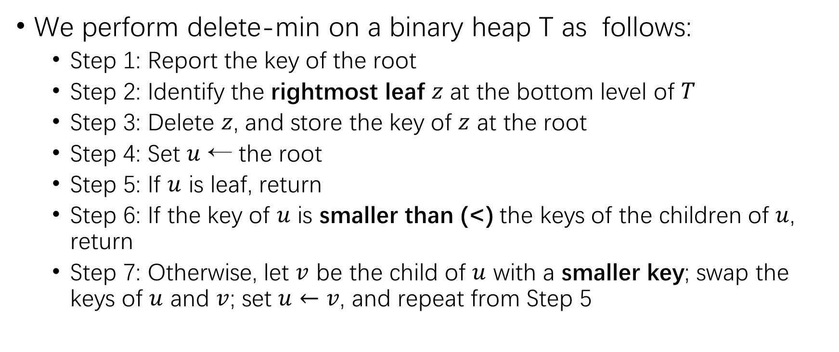
Binary Heap Delete-min
We perform delete-min on a binary heap T as follows:
Step 1: Report the key of the root
Step 2: Identify the rightmost leaf $z$ at the bottom level of $T$
Step 3: Delete $z$, and store the key of $z$ at the root
Step 4: Set $u$ ← the root
Step 5: If $u$ is leaf, return
Step 6: If the key of $u$ is smaller than (<) the keys of the children of $u$, return
Step 7: Otherwise, let $v$ be the child of $u$ with a smaller key; swap the keys of $u$ and $v$; set $u←v$, and repeat from Step 5

Slide 14
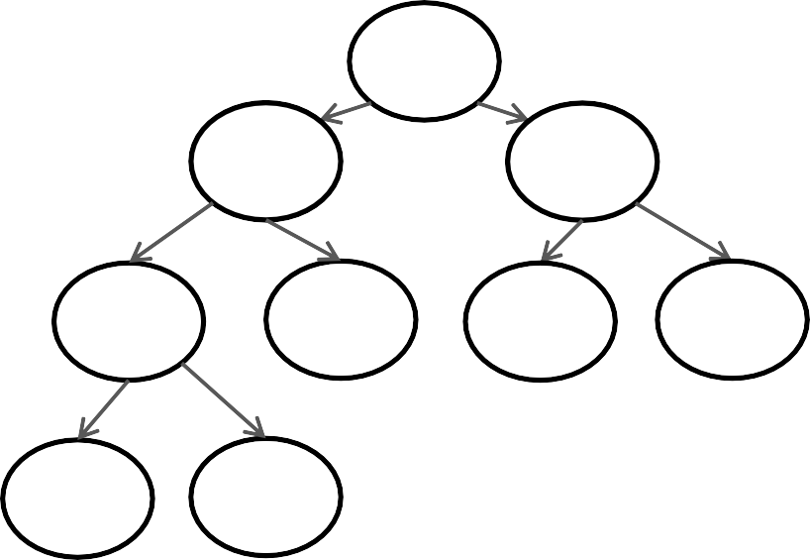
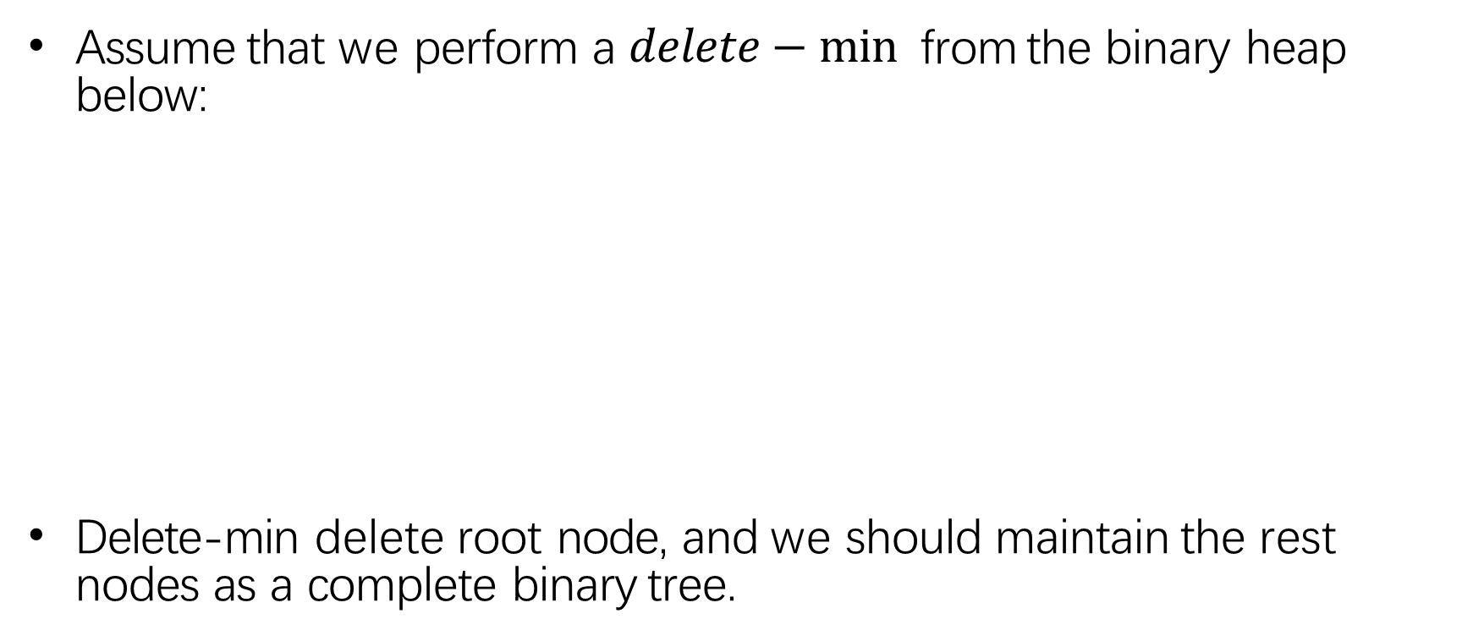
Binary Heap Delete-min
Assume that we perform a $delete−min⁡$ from the binary heap below:
Delete-min delete root node, and we should maintain the rest nodes as a complete binary tree.
1
15
8
39
93 79
54
26
23

Slide 15
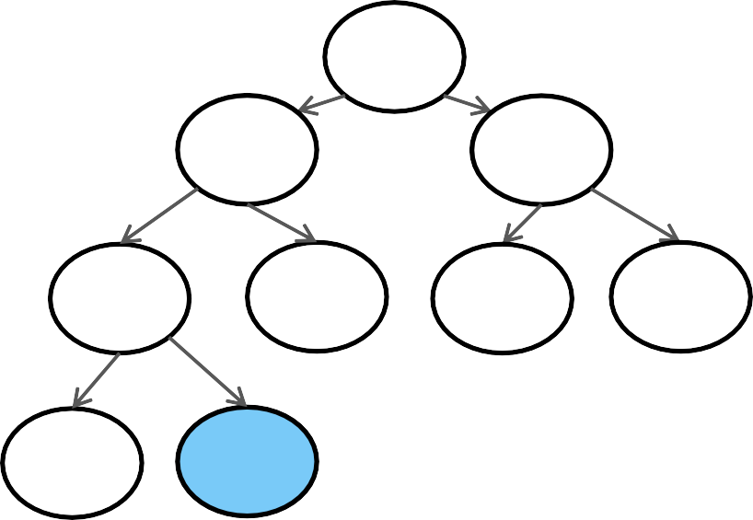
Binary Heap Delete-min
Frist, find the rightmost leaf at the bottom level, it is node with key 79.
Note that the tree is still a complete binary tree after removing this leaf.
1
15
8
39
93 79
54
26
23

Slide 16
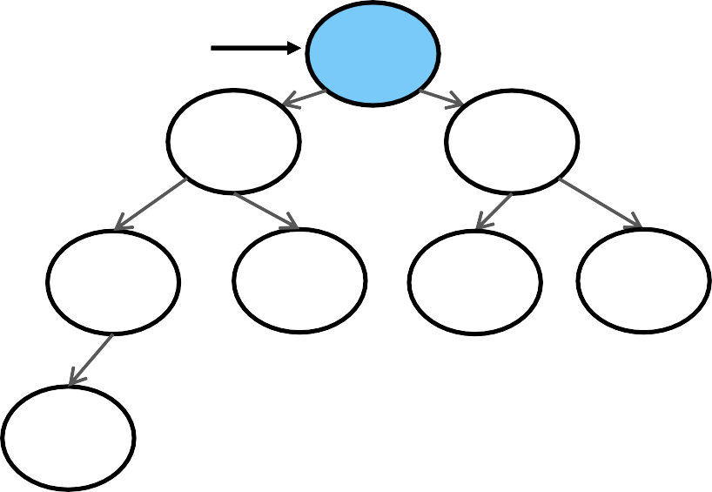
Binary Heap Delete-min
Remove the leaf, BUT place the key value 79 in the root.
Step 4: set u as the root.
Step 5 and 6 are not true,
Go to Step 7.
u
79
15
8
39
54
26
23
93
16

Slide 17
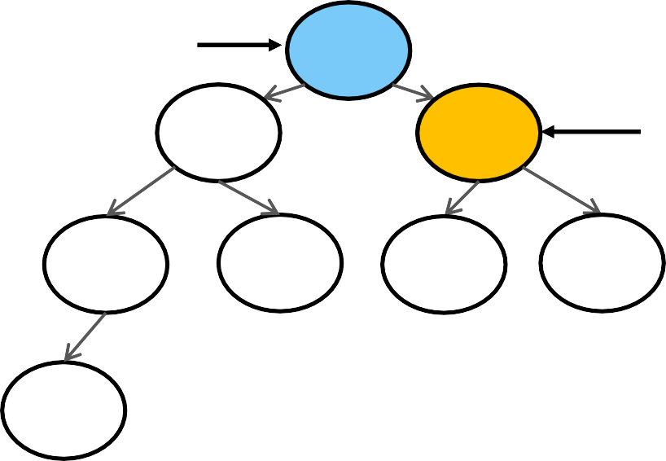
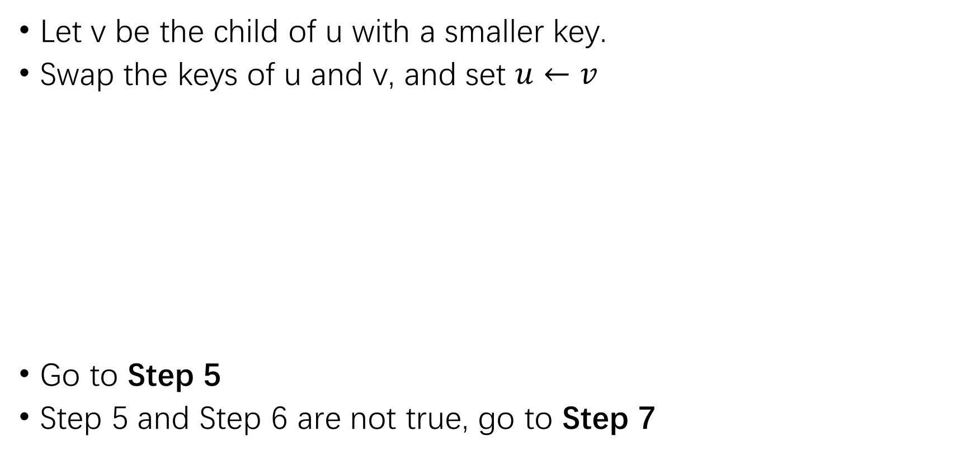
Binary Heap Delete-min
Let v be the child of u with a smaller key.
Swap the keys of u and v, and set $u←v$
Go to Step 5
Step 5 and Step 6 are not true, go to Step 7
u
79 8
15
v
79
u
8 15
39
54
26
23 39
93
54
26
23
93

Slide 18
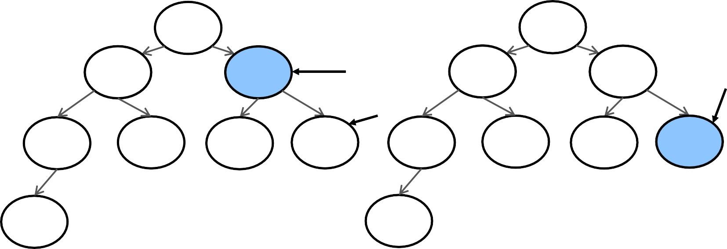
Binary Heap Delete-min
Let v be the child of u with a smaller key.
Swap the keys of u and v, and set $u←v$
Go to Step 5
Step 5 and Step 6 are not true, go to Step 7
8
8
u
u
15 79 15 23
v
39
54 26 23 39 54 26
93
79
93

Slide 19
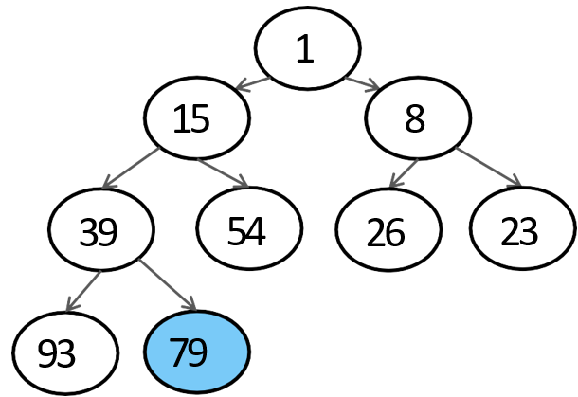
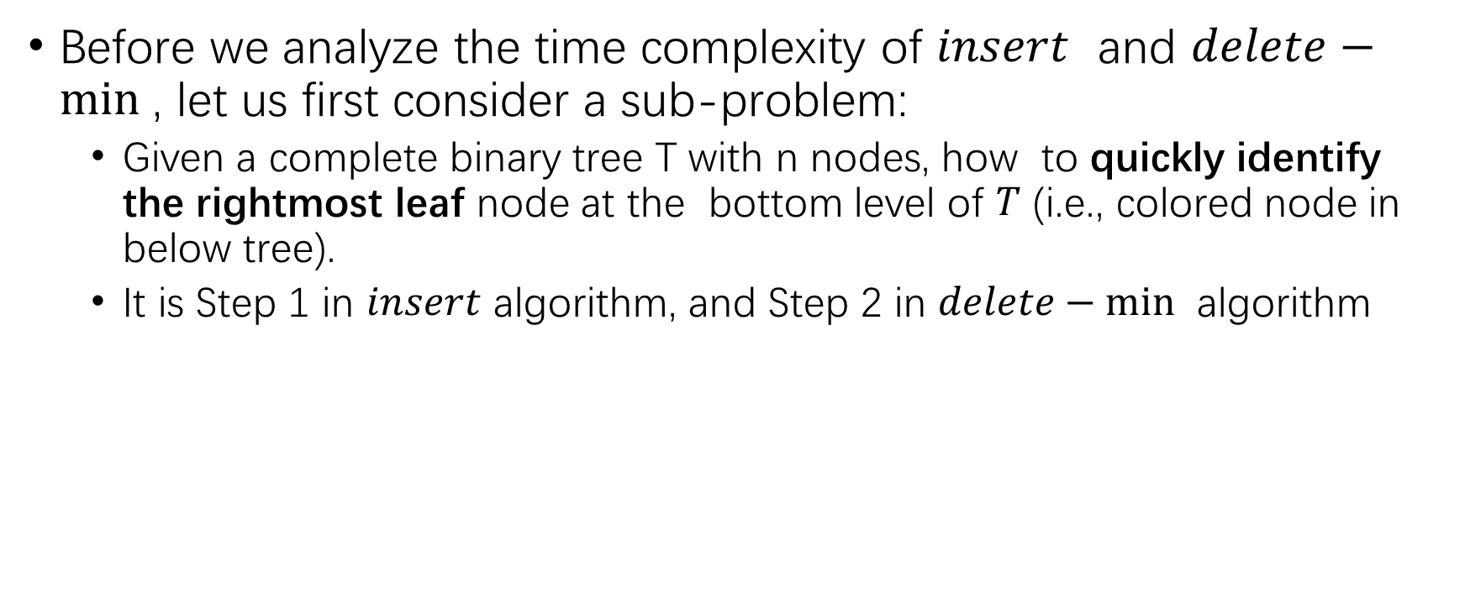
How to find rightmost leaf?
Before we analyze the time complexity of $insert$ and $delete−min⁡$, let us first consider a sub-problem:
Given a complete binary tree T with n nodes, how to quickly identify the rightmost leaf node at the bottom level of $T$ (i.e., colored node in below tree).
It is Step 1 in $insert$ algorithm, and Step 2 in $delete−min⁡$ algorithm

Slide 20
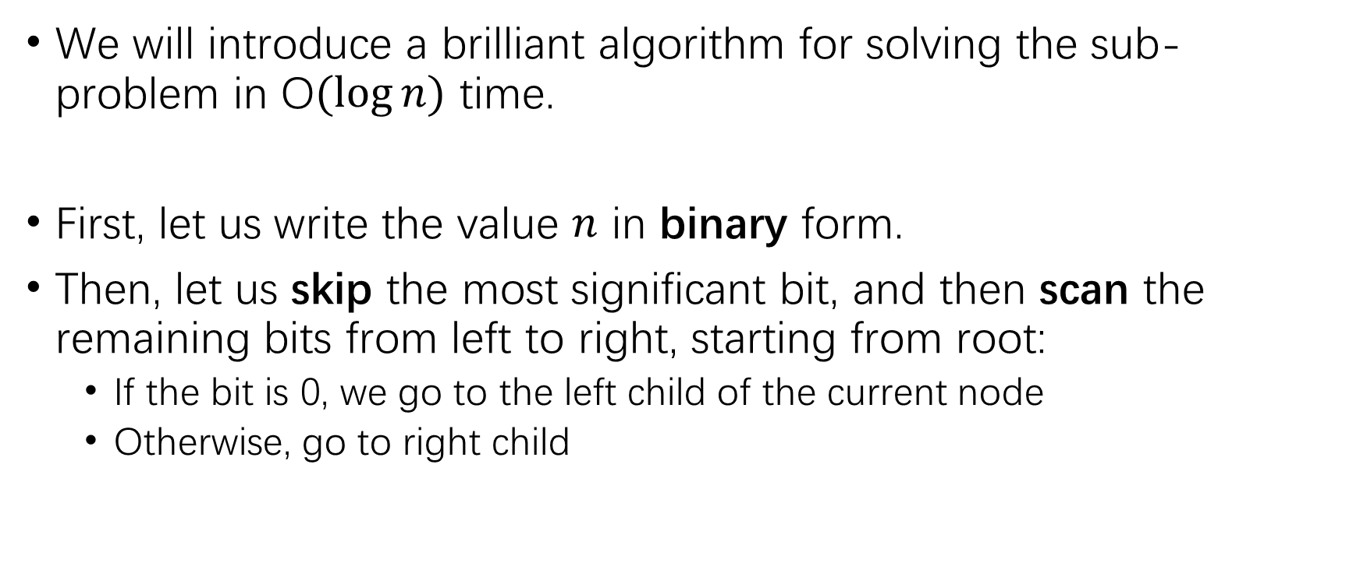
How to find rightmost leaf?
We will introduce a brilliant algorithm for solving the sub-problem in O$(log⁡n)$ time.
First, let us write the value $n$ in binary form.
Then, let us skip the most significant bit, and then scan the remaining bits from left to right, starting from root:
If the bit is 0, we go to the left child of the current node
Otherwise, go to right child

Slide 21
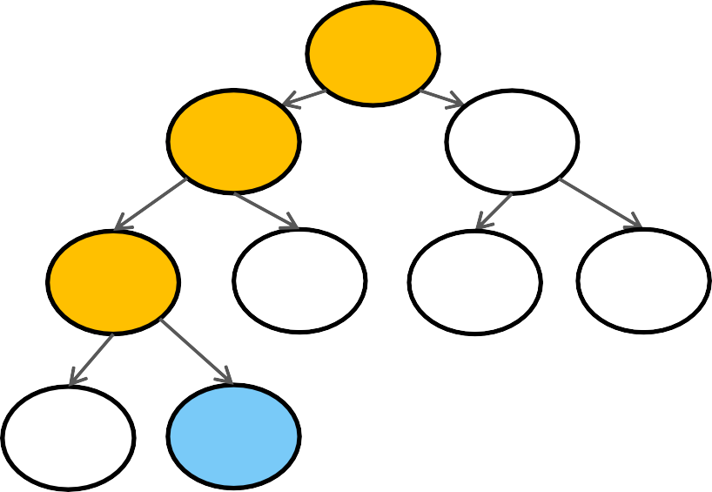
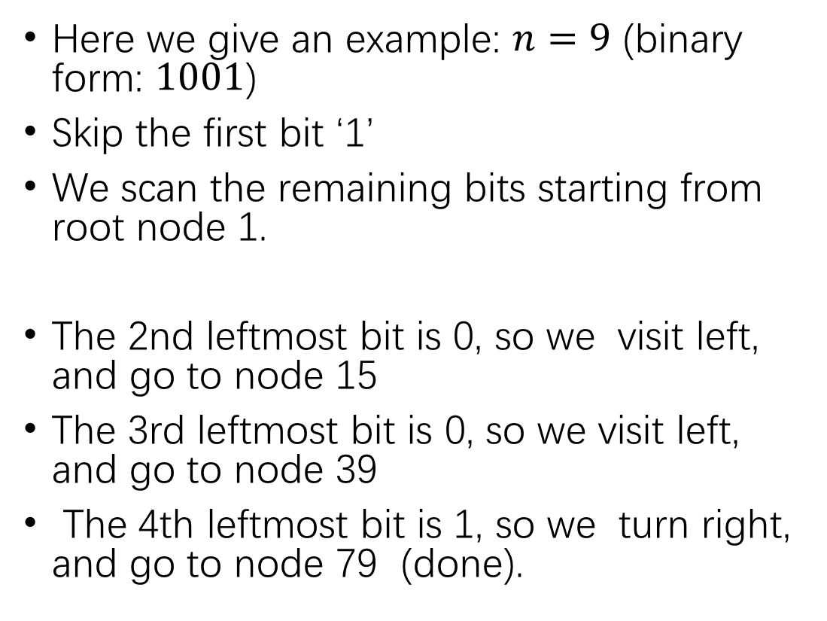
How to find rightmost leaf?
Here we give an example: $n=9$ (binary form: $1001$)
Skip the first bit ‘1’
We scan the remaining bits starting from root node 1.
The 2nd leftmost bit is 0, so we visit left, and go to node 15
The 3rd leftmost bit is 0, so we visit left, and go to node 39
The 4th leftmost bit is 1, so we turn right, and go to node 79 (done).
1
15
8
39
54 26 23
93
79
21

Slide 22
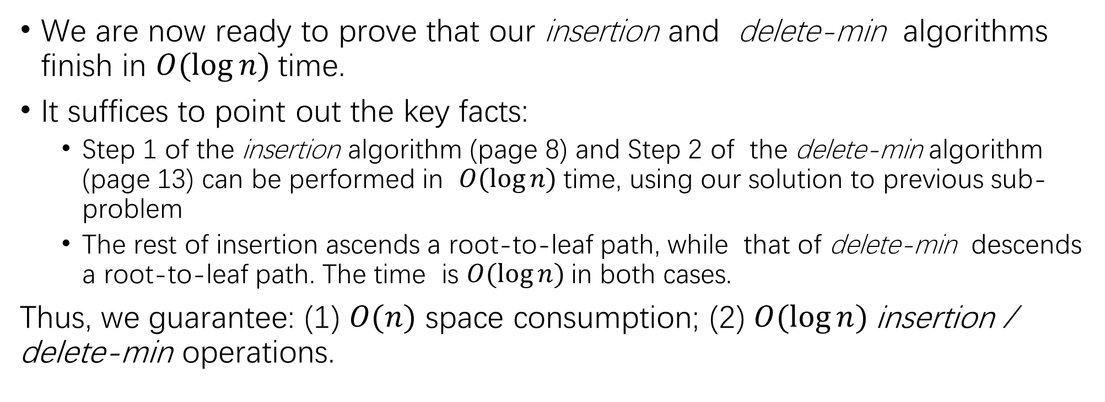
Time Complexity Analysis
We are now ready to prove that our insertion and delete-min$⁡$ algorithms finish in $O(log⁡n)$time.
It suffices to point out the key facts:
Step 1 of the insertion algorithm (page 8) and Step 2 of the delete-min$⁡$algorithm (page 13) can be performed in $O(log⁡n)$time, using our solution to previous sub-problem
The rest of insertion ascends a root-to-leaf path, while that of delete-min$⁡$ descends a root-to-leaf path. The time is $O(log⁡n)$in both cases.
Thus, we guarantee: (1) $O(n)$ space consumption; (2) $O(log⁡n)$insertion / delete-min operations.

Slide 23
Our Roadmap
Priority Queue (binary heap)
Min-heap insert / delete-min
Binary Heaps in Dynamic Arrays
$O(n)$time to build min-heap
Binary Search Tree (BST)
BST operators
Balanced BST (AVL-tree)

Slide 24
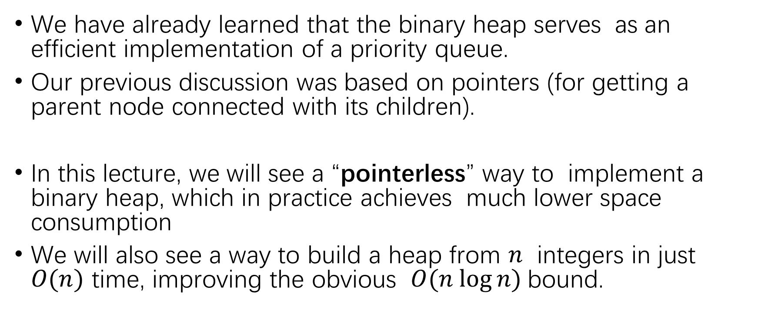
Binary Heaps in Dynamic Arrays
We have already learned that the binary heap serves as an efficient implementation of a priority queue.
Our previous discussion was based on pointers (for getting a parent node connected with its children).
In this lecture, we will see a “pointerless” way to implement a binary heap, which in practice achieves much lower space consumption
We will also see a way to build a heap from $n$ integers in just $O(n)$ time, improving the obvious $O(n log⁡n)$bound.

Slide 25
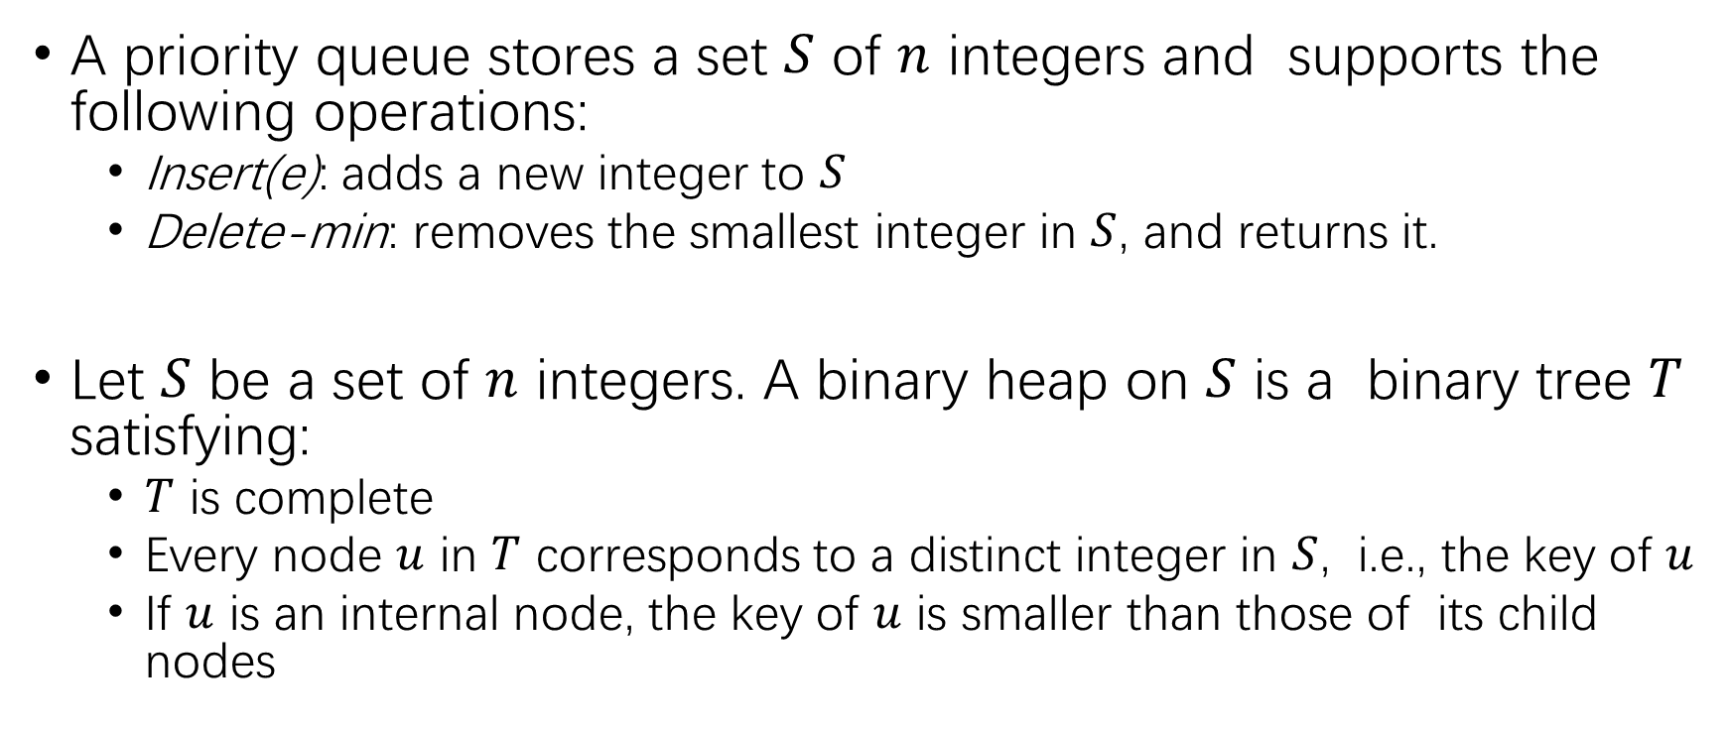
Recall
A priority queue stores a set $S$ of $n$ integers and supports the following operations:
Insert(e): adds a new integer to $S$
Delete-min: removes the smallest integer in $S$, and returns it.
Let $S$ be a set of $n$ integers. A binary heap on $S$ is a binary tree $T$ satisfying:
$T$ is complete
Every node $u$ in $T$ corresponds to a distinct integer in $S$, i.e., the key of $u$
If $u$ is an internal node, the key of $u$ is smaller than those of its child nodes

Slide 26
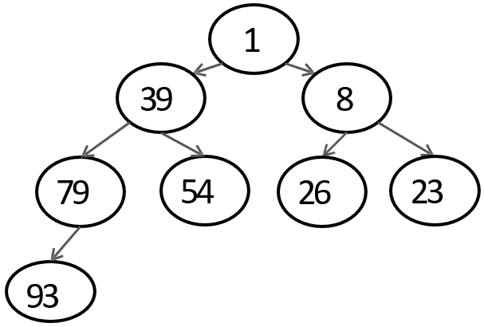
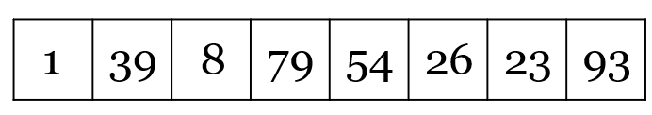
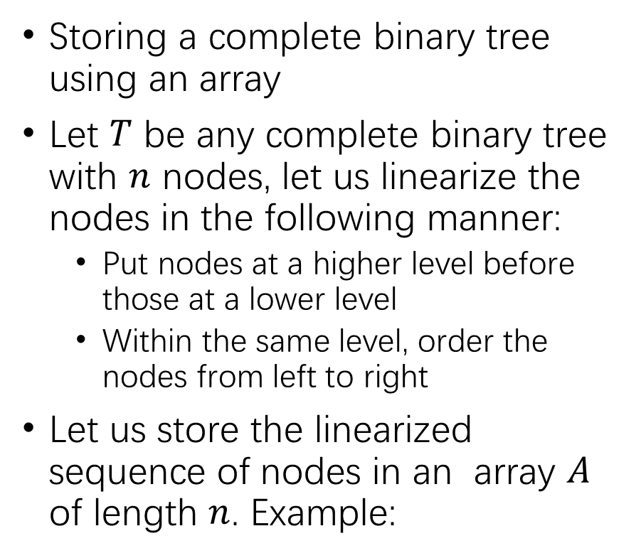
Storing a Complete Binary Tree
Storing a complete binary tree using an array
Let $T$ be any complete binary tree with $n$ nodes, let us linearize the nodes in the following manner:
Put nodes at a higher level before those at a lower level
Within the same level, order the nodes from left to right
Let us store the linearized sequence of nodes in an array $A$ of length $n$. Example:

Slide 27
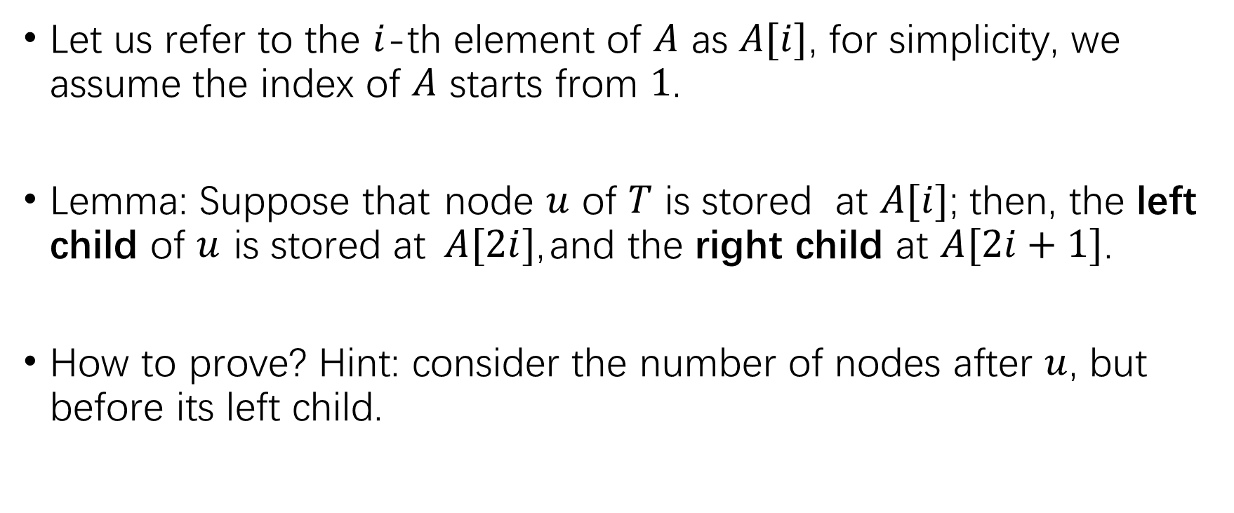
Property I
Let us refer to the $i$-th element of $A$ as $A[i]$, for simplicity, we assume the index of $A$ starts from $1$.
Lemma: Suppose that node $u$ of $T$ is stored at $A[i]$; then, the left child of $u$ is stored at $A[2i]$, and the right child at $A[2i+1]$.
How to prove? Hint: consider the number of nodes after $u$, but before its left child.

Slide 28
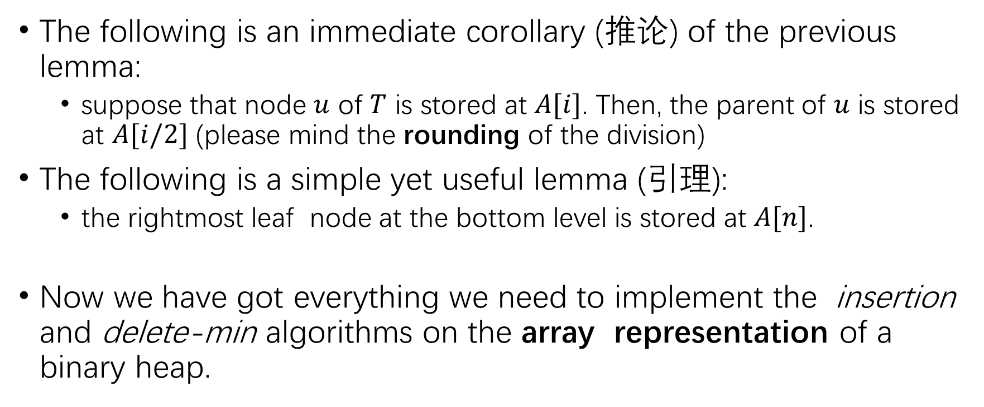
More Properties
The following is an immediate corollary (推论) of the previous lemma:
suppose that node $u$ of $T$ is stored at $A[i]$. Then, the parent of $u$ is stored at $A[i/2]$ (please mind the rounding of the division)
The following is a simple yet useful lemma (引理):
the rightmost leaf node at the bottom level is stored at $A[n]$.
Now we have got everything we need to implement the insertion and delete-min algorithms on the array representation of a binary heap.

Slide 29
Insert 15
1 | 39 | 8 | 79 | 54 | 26 | 23 | 93
1 | 39 | 8 | 79 | 54 | 26 | 23 | 93 | 15
1 | 39 | 8 | 15 | 54 | 26 | 23 | 93 | 79
1 | 15 | 8 | 39 | 54 | 26 | 23 | 93 | 79
29

Slide 30
Delete-min
1 | 15 | 8 | 39 | 54 | 26 | 23 | 93 | 79
79 | 15 | 8 | 39 | 54 | 26 | 23 | 93
8 | 15 | 79 | 39 | 54 | 26 | 23 | 93
8 | 15 | 23 | 39 | 54 | 26 | 79 | 93
30

Slide 31
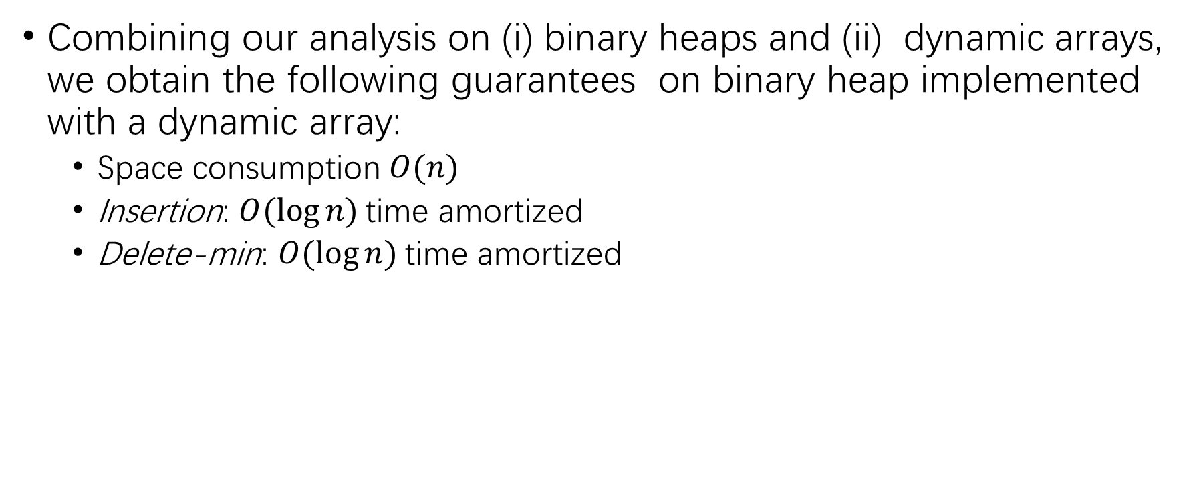
Performance Guarantees
Combining our analysis on (i) binary heaps and (ii) dynamic arrays, we obtain the following guarantees on binary heap implemented with a dynamic array:
Space consumption $O(n)$
Insertion: $O(log⁡n)$time amortized
Delete-min: $O(log⁡n)$time amortized

Slide 32
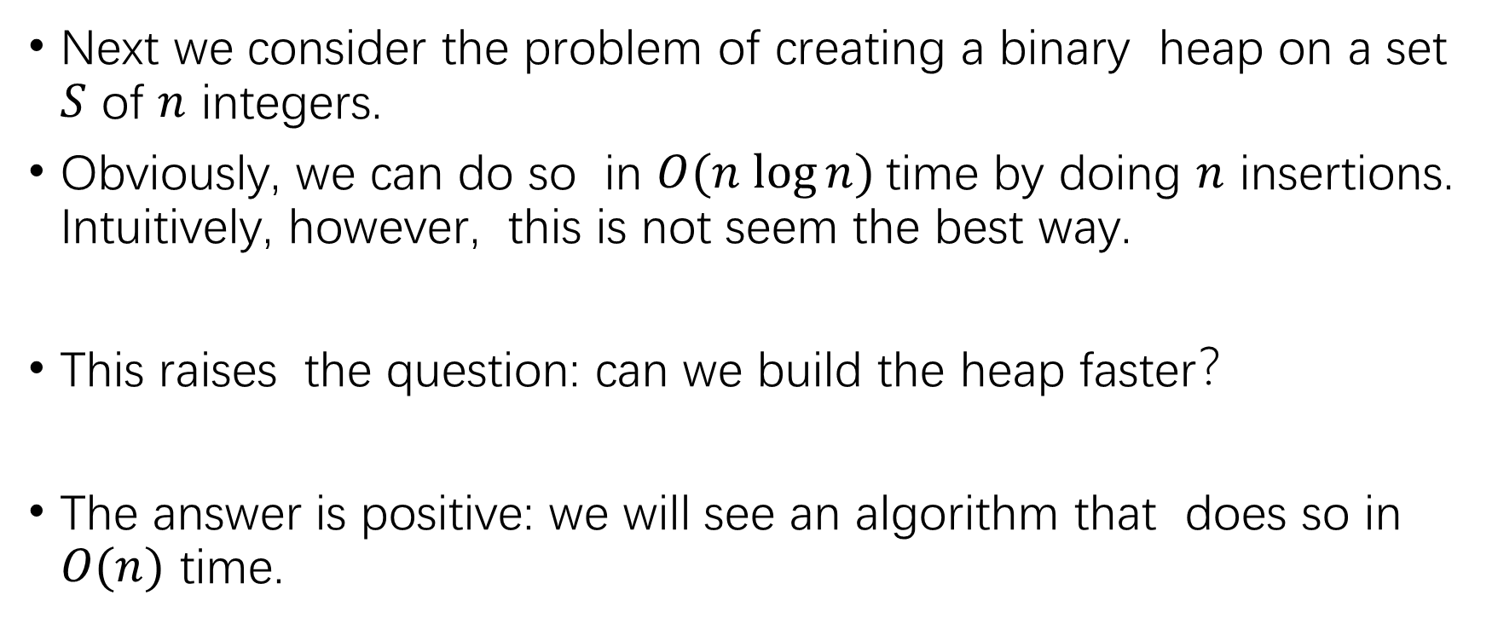
Build a Binary Heap in Array
Next we consider the problem of creating a binary heap on a set $S$ of $n$ integers.
Obviously, we can do so in $O(n log⁡n)$time by doing $n$ insertions. Intuitively, however, this is not seem the best way.
This raises the question: can we build the heap faster？
The answer is positive: we will see an algorithm that does so in $O(n)$ time.

Slide 33
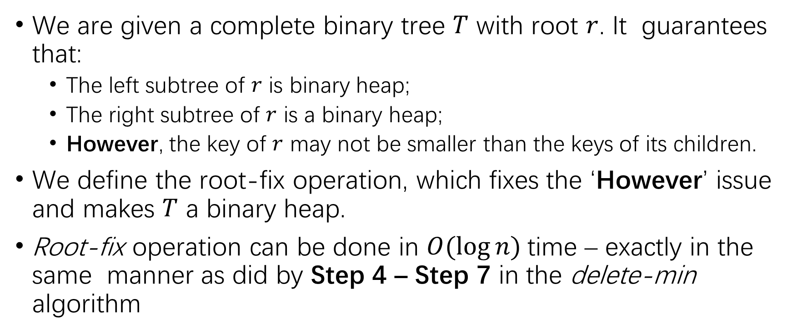
Root-fix Operator
We are given a complete binary tree $T$ with root $r$. It guarantees that:
The left subtree of $r$ is binary heap;
The right subtree of $r$ is a binary heap;
However, the key of $r$ may not be smaller than the keys of its children.
We define the root-fix operation, which fixes the ‘However’ issue and makes $T$ a binary heap.
Root-fix operation can be done in $O(log⁡n)$time – exactly in the same manner as did by Step 4 – Step 7 in the delete-min algorithm

Slide 34
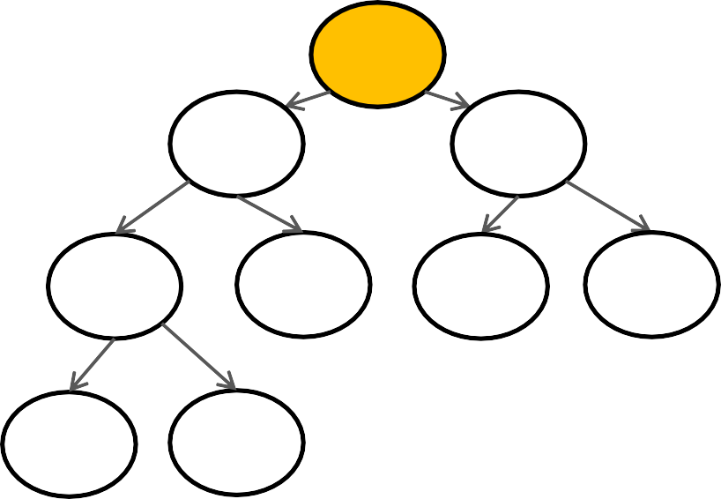
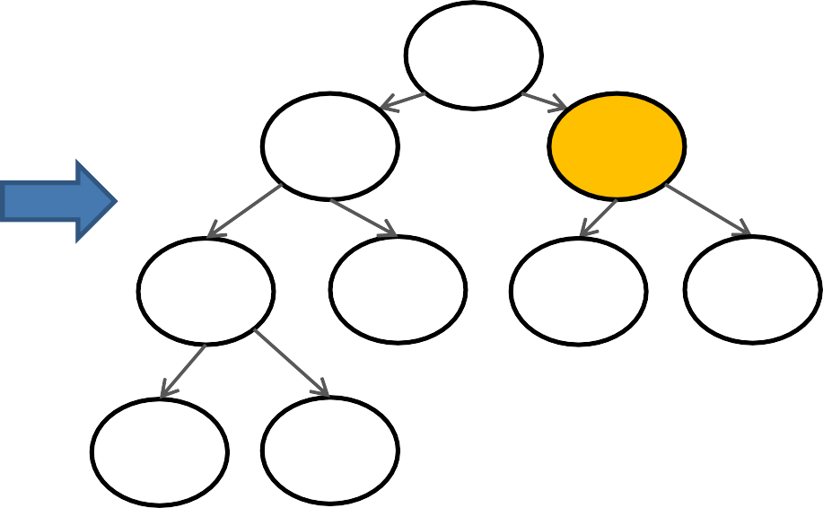
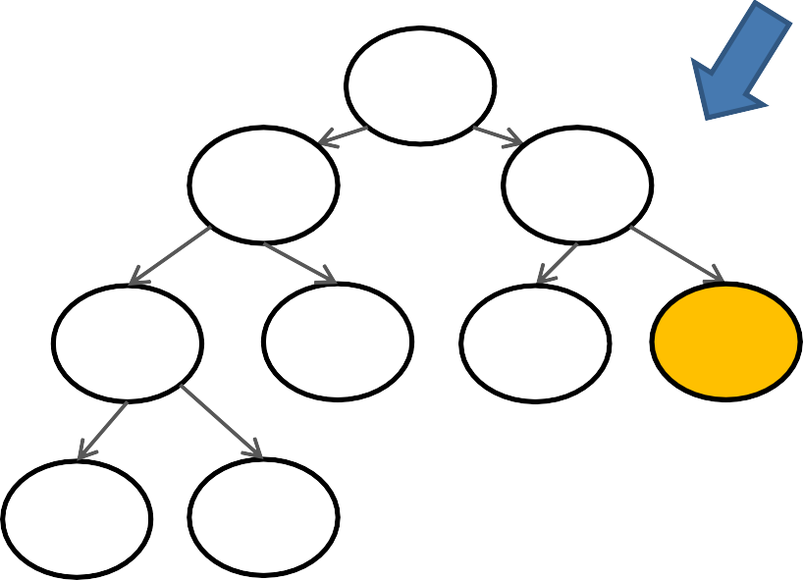
Root-fix Example
25 8
8 15
26 23 39 54 26
93 79
15
25
39
54
23
93
79
8
15
23
39
54
26
25
93
79
34

Slide 35
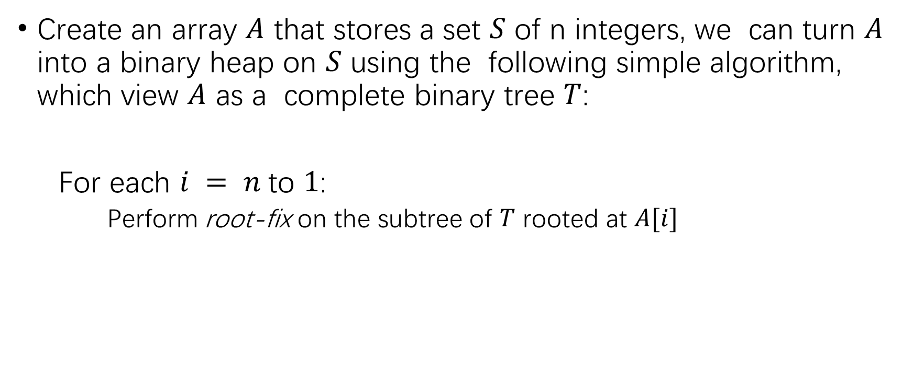
Building a Heap with Root-fix Operator
Create an array $A$ that stores a set $S$ of n integers, we can turn $A$ into a binary heap on $S$ using the following simple algorithm, which view $A$ as a complete binary tree $T$:
For each $i = n$to $1$:
Perform root-fix on the subtree of $T$ rooted at $A[i]$

Slide 36
Example of Building a Heap with Array
54 | 26 | 15 | 93 | 8 | 1 | 23 | 39
54 | 26 | 15 | 93 | 8 | 1 | 23 | 39
54 | 26 | 15 | 93 | 8 | 1 | 23 | 39
54 | 26 | 15 | 93 | 8 | 1 | 23 | 39
54 | 26 | 15 | 93 | 8 | 1 | 23 | 39
54 | 26 | 15 | 39 | 8 | 1 | 23 | 93
54 | 26 | 1 | 39 | 8 | 15 | 23 | 93
54 | 8 | 1 | 39 | 26 | 15 | 23 | 93
Root-fix
54 | 26 | 15 | 39 | 8 | 1 | 23 | 93
54 | 26 | 1 | 39 | 8 | 15 | 23 | 93
54 | 8 | 1 | 39 | 26 | 15 | 23 | 93
1 | 8 | 15 | 39 | 26 | 54 | 23 | 93

Slide 37
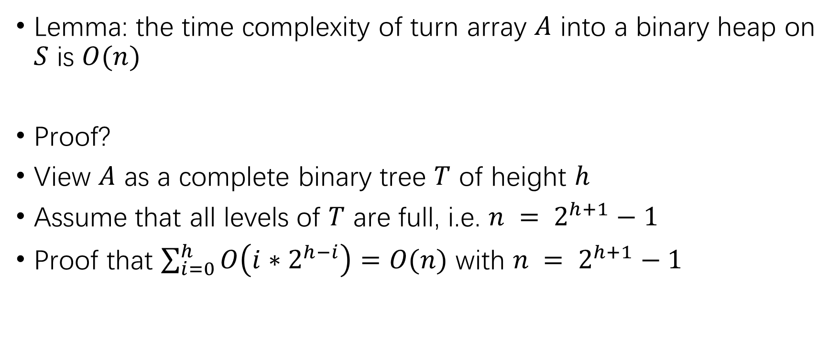
Complexity analysis
Lemma: the time complexity of turn array $A$ into a binary heap on $S$ is $O(n)$
Proof?
View $A$ as a complete binary tree $T$ of height $h$
Assume that all levels of $T$ are full, i.e. $n = 2^{h+1}−1$
Proof that $\sum_{i=0}^{h}{O\left(i∗2^{h−i}\right)=O(n)}$ with $n = 2^{h+1}−1$

Slide 38
Our Roadmap
Priority Queue (binary heap)
Min-heap insert / delete-min
Binary Heaps in Dynamic Arrays
$O(n)$time to build min-heap
Binary Search Tree (BST)
BST operators
Balanced BST (AVL-tree)

Slide 39
Binary Search Tree (BST)
Binary Search Tree (especially, balanced BST) is one of the most important data structures in computer science.
In extreme case, BST is equivalent to a linked list; thus, we guarantee the operations performance of BST by studying AVL-tree (Adelson-Velsky and Landis).

Slide 40
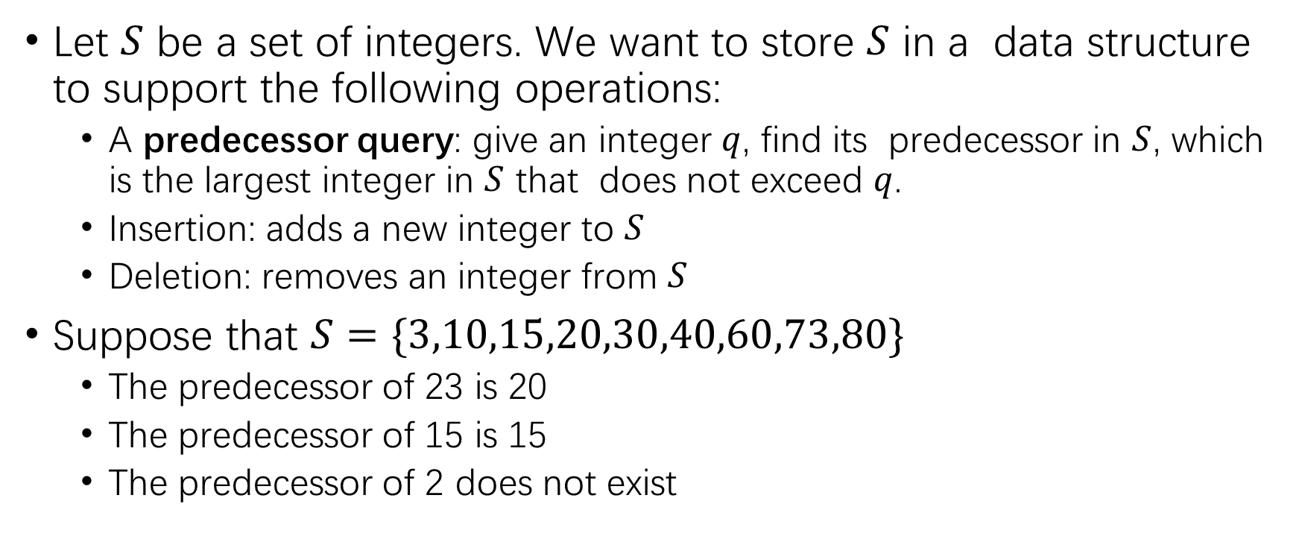
The Task: Dynamic Predecessor Search
Let $S$ be a set of integers. We want to store $S$ in a data structure to support the following operations:
A predecessor query: give an integer $q$, find its predecessor in $S$, which is the largest integer in $S$ that does not exceed $q$.
Insertion: adds a new integer to $S$
Deletion: removes an integer from $S$
Suppose that $S=\{3,10,15,20,30,40,60,73,80\}$
The predecessor of 23 is 20
The predecessor of 15 is 15
The predecessor of 2 does not exist

Slide 41
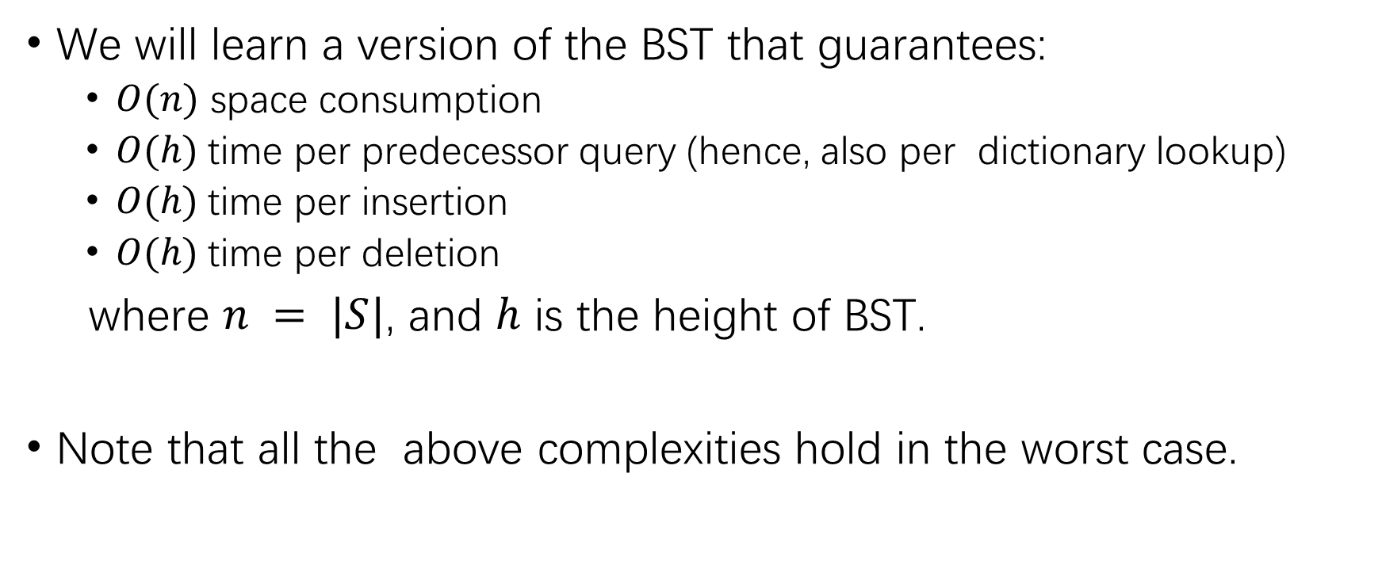
Binary Search Tree (BST)
We will learn a version of the BST that guarantees:
$O(n)$ space consumption
$O(h)$time per predecessor query (hence, also per dictionary lookup)
$O(h)$time per insertion
$O(h)$time per deletion
where $n = |S|$, and $h$ is the height of BST.
Note that all the above complexities hold in the worst case.

Slide 42
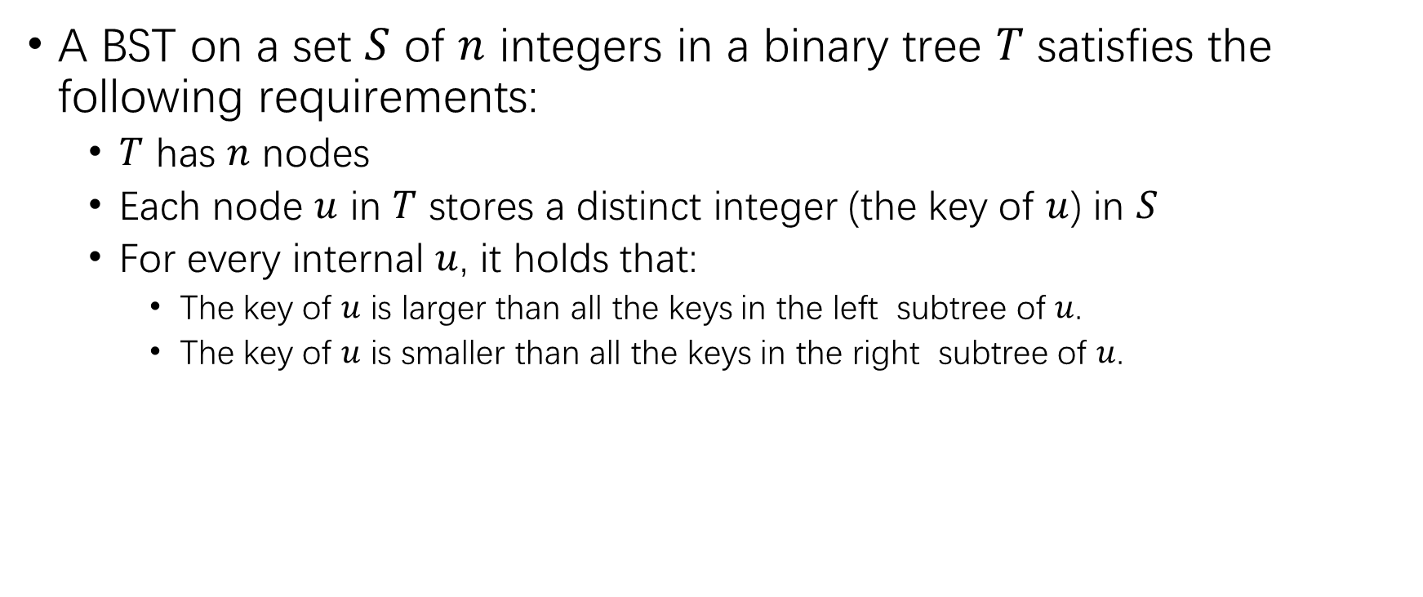
Binary Search Tree (BST)
A BST on a set $S$ of $n$ integers in a binary tree $T$ satisfies the following requirements:
$T$ has $n$ nodes
Each node $u$ in $T$ stores a distinct integer (the key of $u$) in $S$
For every internal $u$, it holds that:
The key of $u$ is larger than all the keys in the left subtree of $u$.
The key of $u$ is smaller than all the keys in the right subtree of $u$.

Slide 43
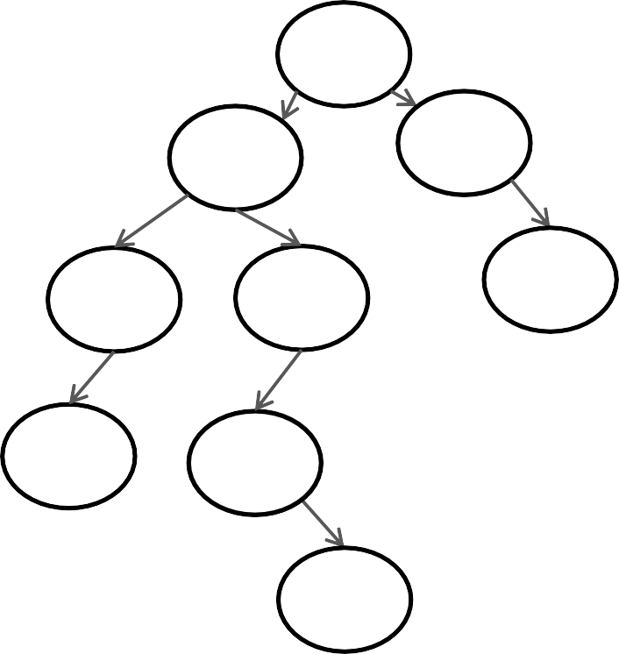
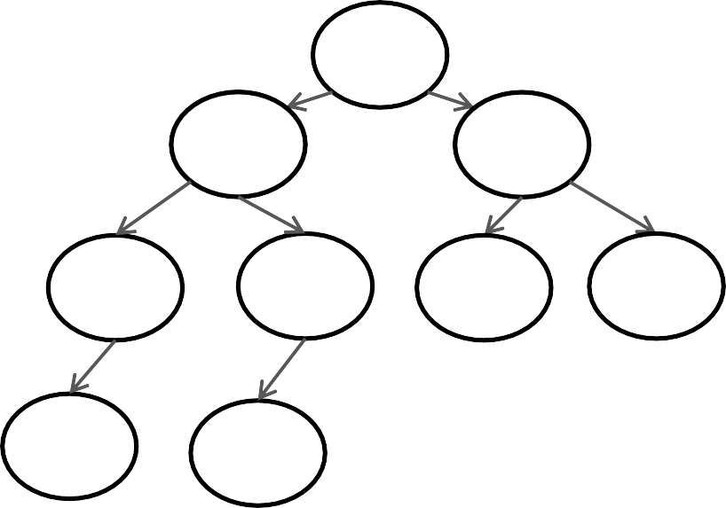
BST Example
Two possible BSTs on $S= \{3,10,15,20,30,40,60,73,80\}$
60
40
73
15
15
73
10
40
80
10
30
60
80
3
20
3
20
30

Slide 44

Predecessor Query
Suppose that we have created a BST T on a set $S$ of $n$ integers, a predecessor query with search value $q$ can be answered by descending a single root-to-leaf path:
(1) Set $p ← −∞$($p$ will contain the final answer at the end)
(2) Set $u$ $←$ the root of $T$
(3) If $u=nil$, then return $p$
(4) If key of $q=u$, then set $p$ to $q$, and return $p$
(5) If key of $q<u$, then set $u$ to the left child (now $u=nil$if there is no left child), and repeat from Step (3)
(6) Otherwise (i.e. $q>u$), then set $p$ to the key of $u$ and set $u$ to the right child, and repeat from Step (3)

Slide 45


Predecessor Query Example
Suppose that we want to find the predecessor of 35
Set 𝑝 ← −∞ , $u =root 40$
(3) and (4) are not true, go to (5)
Since $40>35$, the predecessor cannot be in the right subtree of 40,
so we move to the left child of 40, now $u =node 15$.
u
40
15
73
10
30
60
80
3
20

Slide 46

Predecessor Query Example
Suppose that we want to find the predecessor of 35
Set 𝑝 ← −∞ , $u =root 40$
(3) and (4) are not true, go to (5)
Since $40>35$, the predecessor cannot be in the right subtree of 40,
so we move to the left child of 40, now $u =node 15$.
p
40
u
15
73
10
30
60
80
3
20

Slide 47

Predecessor Query Example
Suppose that we want to find the predecessor of 35
(3), (4) and (5) are not true, go to (6)
Since 15 < 35, 𝑝 = 15 is the predecessor of 35 so far
The predecessor cannot be in the left subtree of 15, so we move 𝑢 to the right child, now 𝑢 = 𝑛𝑜𝑑𝑒 30.
p
40
15
73
10
30
60
80
3
20
u
47

Slide 48

Predecessor Query Example
Suppose that we want to find the predecessor of 35
(3), (4) and (5) are not true, go to (6)
Since $30<35$, $p=30$ is the predecessor of 35 so far.
The predecessor will be in the right subtree of 30, but 30 does not have a right child, so the algorithm terminates here with $p=30$ as the final answer
40
15
73
10
30
60
80
3
20
p
u
47

Slide 49

Time Complexity Analysis
Obviously, we spend $O(1)$ time at each node visited.
Since the height of BST is $h$, therefore the total query time is $O(h)$.

Slide 50

Successor Query
The opposite of predecessors are successors.
The successors of $n$ integer $q$ in $S$ is the smallest integer in $S$ that is no smaller than $q$
Suppose that $S=\{3,10,15,20,30,40,60,73,80\}$
The successor of 23 is 30
The successor of 15 is 15
The successor of 81 does not exist
Given an integer $q$, a successor query returns the successor of $q$ in $S$
By symmetry, we know from the earlier discussion (on predecessor queries) that a successor query can be answered using a BST in $O(h)$time

Slide 51

BST Insertion
Suppose that we need to insert a new integer $e$. First create a new leaf $z$ storing the key $e$. This can be done by descending a root-to-leaf path:
1. Set $u$ as the root of $T$
2. If $e$ < the key of $u$
2.1 If $u$ has a left child, then set $u$ to the left child
2.2 Otherwise, make $z$ the left child of $u$, and done
3. Otherwise:
3.1 If $u$ has a right child, then set $u$ to the right child
3.2 Otherwise, make $z$ the right child of $u$, and done
4. Repeat from Step 2.
The total cost is proportional to the height of $T$, i.e., $O(h)$

Slide 52


BST Insertion Example
Inserting 35:
$u$ is root 40, $e$ < the key of $u$, $u$ has a left child, u ← node 15;
$u$ is node 15, $e$ > the key of $u$
$u$ has a right child, $u$ ← node 30;
$u$ is node 30, $e$ > the key of $u$, $u$’s right child is $nil$, then set $z$ as the right child of $u$.
Done.
40
15
73
10
30
60
80
3
20 35

Slide 53



BST Deletion
Suppose that we want to delete an integer $e$. Frist, find the node $u$ whose key equals to $e$ in $O(h)$ time (through a predecessor query).
Case 1: if $u$ is a leaf node, simply remove it from $T$.
Example: remove 60
30
30
15
40
15
40
10
20
35
73
10
20
35
73
3
36 60
3
36

Slide 54

BST Deletion
What happens if node $u$ is not a leaf node?
Case 2: if $u$ has a right subtree:
Find the node $v$ storing the successor $s$ of $e$.
Copy node $v$ to node $u$
Case 2.1: if $v$ is a leaf node, then remove it from $T$
Case 2.2: otherwise, it must hold that $v$ has a right child $w$, but not left child. Replace node $v$ by subtree which is rooted at $w$.
Case 3: if $u$ has no right subtree:
It must hold that $u$ has a left child $v$. Replace node $u$ by the subtree rooted at $v$.

Slide 55



Case 2.1 Example
Delete 40:
$u$ has a right subtree, node $v$ (60) is the successor of 40.
Set the key of $u$ to 60
$v$ is a leaf, remove node $v$, done.
30
30
15
40
15
60
10
20 35
73
10
20 35
73
3
36 60
3
36

Slide 56



Case 2.2 Example
Delete 30:
$u$ has a right subtree, node $v$ (35) is the successor of 30.
Set the key of $u$ to 35
$v$ is not leaf node, it has right child $w$ (36), replace node $v$ by subtree rooted at $w$ (36).
30
35
15 15
40 40
10
20 35
36 60
10 20 36
73
73
3
3
60

Slide 57



Case 3 Example
Delete 73:
$u$ has no right subtree, and $u$ must have a left child $v$ (60), replace node $u$ by node $v$ (60).
done.
30
35
15
40
15
40
10
20 35
73
10
20 35
60
3
36 60
3
36

Slide 58

Time Complexity of BST
In all above cases, we have essentially descended a root-to-leaf path (call it deletion path), and removed a leaf node.
The cost so far is $O(h)$, recall that the successor of an integer can be found in $O(h)$ time.
Given a set $S$ of $n$ integers, what is the maximum possible height of its BST?
$h=n$, why?
So what is the worst-case query cost? $O(n)$
However, we can guarantee $h=O(log⁡n)$ with balanced BST.

Slide 59



Balanced Binary Tree
A binary tree $T$ is balanced if the following holds on every internal node $u$ of $T$:
The height of the left subtree of $u$ differs from that of the right subtree of $u$ by at most 1.
If $u$ violates the above requirement, we say that $u$ is imbalanced.
60
40
15
73
15
73
10
40
80
10
30
60
80
Not balanced
Node 60, 40
3
20
3
20
Balanced
30

Slide 60

Height of a Balanced Binary Tree
Theorem: a balanced binary tree with $n$ nodes has height $O(\log{n})$.
With the height of balanced binary tree being $O(log⁡n)$, we can conclude that the cost of query/insertion/deletion operation is $O(log⁡n)$ on a balanced BST.
Proof?

Slide 61


Balanced BST
An AVL-tree on a set $S$ of $n$ integers is a balanced binary search tree $T$, where the following holds on every internal node $u$
$u$ stores the heights of its left and right subtrees.
height difference of its left and right subtrees is no more than 1
An AVL-tree on $S = \{3,10,15,20,30,40,60,73,80\}$
By storing the subtree heights, an internal node knows whether it has become imbalanced
40
3
2
15
2
30
0 1
20
73
2
1
80
1
10
60
0
3

Slide 62

Balanced BST
Next we will explain how to perform updates. The most important step is to remedy a node $u$ when it becomes imbalanced.
It suffices to consider a situation called 2-level imbalance. In this situation, two conditions apply:
There is a difference of 2 in the heights of the left subtree and right subtree of $u$.
All the proper descendants of $u$ are balanced
We will first explain how to rebalance $u$ in the above situation
Demo: https://www.cs.usfca.edu/~galles/visualization/AVLtree.html

Slide 63
2-Level Imbalance
h+2
h
h
h+2
Due to symmetry, it suffices to explain only the left case, which can be further divided to a left-left and a left-right case, as shown next.

Slide 64
2-Level Imbalance
Two cases of left case
h
h
h
h+1
h or h+1
h+1
Left-Left case
Left-Right case

Slide 65

Rebalance Left-Left Case
By a rotation
Only 3 pointers to change (the red ones). The cost is $O(1)$.
Note that $x$must be $h$or $h+1$
a
b
x+1
a
x
h+2
h
h+1
b
h+1
x
h
h
C
h+1
A
C
A
B
B

Slide 66


Rebalance Left-Left Case
40
40
15
73
15
73
10
30
60
80
3
30
60
80
2
0
1
1 10 20
1
3
0
20
1
1

Slide 67

Rebalance Left-Right Case
By double rotation
Only 5 pointers to change (see above). Hence, the cost is $O(1)$.
Note that $x$ and $y$ must be $h$ or $h−1$, and at least one of them must be $h$.
How?
h+2 h+2
h+1
b
c
a a
h+1 _{y} a
h h
^{b} h+1 x ^{c} y
h
^{b} h+1
h
h
x
h
D
h+1
A
A
B
C
D
B C

Slide 68


Rebalance Left-Right Case
By double rotation
Only 5 pointers to change (see above). Hence, the cost is $O(1)$.
Note that $x$ and $y$ must be $h$ or $h−1$, and at least one of them must be $h$.

Slide 69

Rebalance Left-Right Case
4
40
30
2
3
3
15
3
30
1
73
2
10
15
2
10 20
2
35
40
1
2
60
80
2
73
3
20
35
3
36
60
80
36

Slide 70

Time Complexity of Balanced BST
We now conclude our discussion on the AVL-tree, which provides the following guarantees:
$O(n)$space consumption
$O(log⁡n)$ time per predecessor query (hence, also per dictionary lookup)
$O(log⁡n)$time per insertion
$O(log⁡n)$time per deletion
All the above complexities hold in the worst case.

Slide 71
Thank you

